Slide 1


IIIT BHOPAL
Humor Detection in Hindi-English Code-Mixed Social Media Text Using Transformer Based Models
SUBMITTED BY
SUPERVISED BY
Dhruv Nihate (24U023020)
Sanyam Jain (24U023022)
Dr. Ringki Das
Department of Computer Science and Engineering
Indian Institute of Information Technology, Bhopal (IIIT Bhopal)
Notes:
Welcome the panel, introduce yourself and your partner, and state the project title clearly.
1

Slide 2
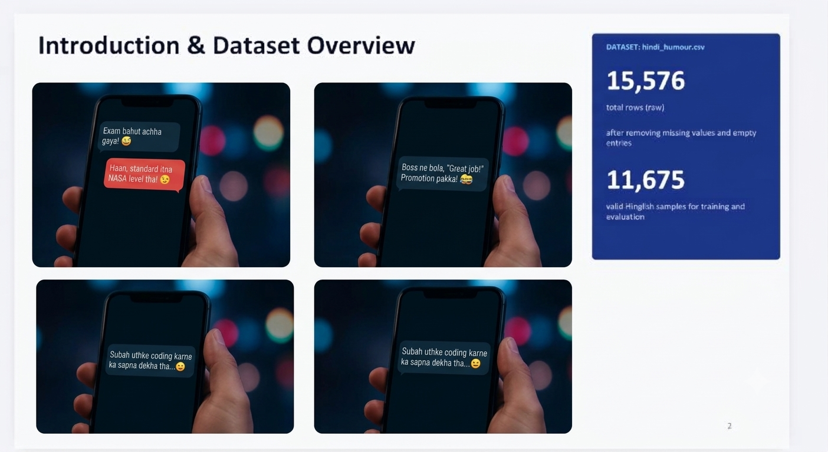
Introduction & Dataset Overview
DATASET: hindi_humour.csv
15,576
Background & Motivation
total rows (raw)
Social media is a primary channel of communication, where humor, irony and sarcasm keep conversations engaging. Detecting humor supports conversational AI, sentiment analysis and social network monitoring.
after removing missing values and empty entries
11,675
valid Hinglish samples for training and evaluation
The Code-Mixing Challenge (Hinglish)
Users mix Hindi and English in one sentence using Roman script, slang, inconsistent spellings and shifting grammar, which makes traditional monolingual NLP models fail.
example: मेरी watch 2 और 2.30 के बीच अटक गई है। It's a do or die situation.
Project Aim
Develop and evaluate an XLM-RoBERTa framework that classifies social media text as Humorous or Non-Humorous.
Humorous
Notes:
Explain how people talk online using Hinglish and why teaching a computer to detect a joke in mixed languages is tough and interesting. Then introduce the dataset: 15,576 raw rows, 11,675 after cleaning.
2

Slide 3

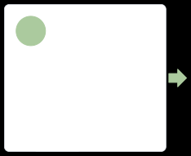
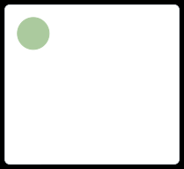

Literature Review / Background
Evolution of approaches and the code-mixed gap.
1
1
2
3
4
TRADITIONAL NLP
DEEP LEARNING
Transformers
CODE-MIXED GAP
2
Handicraft rules ,Bag-of-Words
CNN’s and LSTM’s for
Self-attentionandmodels
Needfor Hinglishhumor
TF-IDF + Naive-Bayes
text classification
like BERT, XLM-R
detection evaluation
Mihalcea & Strapparava, 2005 Salton & Buckley, 1988
Kim, 2014
Chen and Lee, 2017
Vaswani et al., 2017 Devlin et al., 2019 Conneau et al., 2020
Khandelwal et al., 2018 Khanuja et al., 2020
Research has advanced from rule-based methods to transformer models, yet Hinglish humor detection remains an under-explored niche.

Slide 4
Problem Statement & Objectives
Project Objectives
Problem Definition
Building an automated text classification model to determine whether a given Hinglish (Hindi-English code-mixed) social media sentence is Humorous or Non-Humorous.
Key Challenges
  Mixed Languages & Scripts: Users mix Hindi and English words together using Roman script, making standard dictionary lookups fail.
  Spelling Variations: The same word can be spelled in multiple casual ways (e.g., "tumhaaree" vs. "tumhari").
  Conflicting Data Labels: About 19.5% of the dataset rows contain label conflicts, where identical sentences are sometimes marked as funny and other times as serious.
  Missing Dialogue Context: Sentences are analyzed entirely on their own, without knowing what was said right before them in a conversation.
Data Preparation & Cleaning :
Load and clean the raw hindi_humour.csv dataset, eliminate missing values, and structure balanced data partitions.
1
Transformer Fine-Tuning:
Adapt the pretrained multilingual transformer (XLM-RoBERTa-base) by adding a custom classification head to learn deep contextual patterns.
2
Rigorous Evaluation & Benchmarking :
Evaluate model performance using robust metrics (Accuracy, Precision, Recall, and Weighted F1-score) and establish a comparative benchmark against classical ML baselines (Naive Bayes, Logistic Regression, Linear SVM).
3
4
Notes:
Point out the unique difficulties of Hinglish text (mixed scripts, spelling variations) and state clearly what the system sets out to achieve.
4

Slide 5
Proposed Methodology
1
Dataset Loading
2
Preprocessing
3
Stratified Split
Raw CSV input: 15,576 rows
Remove missing values, strip whitespace: 11,675 cleaned rows
80% train (9,340), 10% validation (1,167), 10% test (1,168)
4
Tokenization
5
Model Training
6
Evaluation & Prediction
SentencePiece subwords (xlm-roberta-base), max length 128
Fine-tune XLM-R with a 2-class classification head
Accuracy and weighted F1-score on the test set
Why XLM-RoBERTa? Pre-trained on 100 languages, it provides a shared embedding space for processing mixed Hindi-English vocabulary.
5
Notes:
Walk the panel through the pipeline from raw CSV to tokenization, training and final classification. You can add Fig 1 (System Block Diagram) or Fig 2 (XLM-R Architecture) from your report if you want an image here.
5

Slide 6
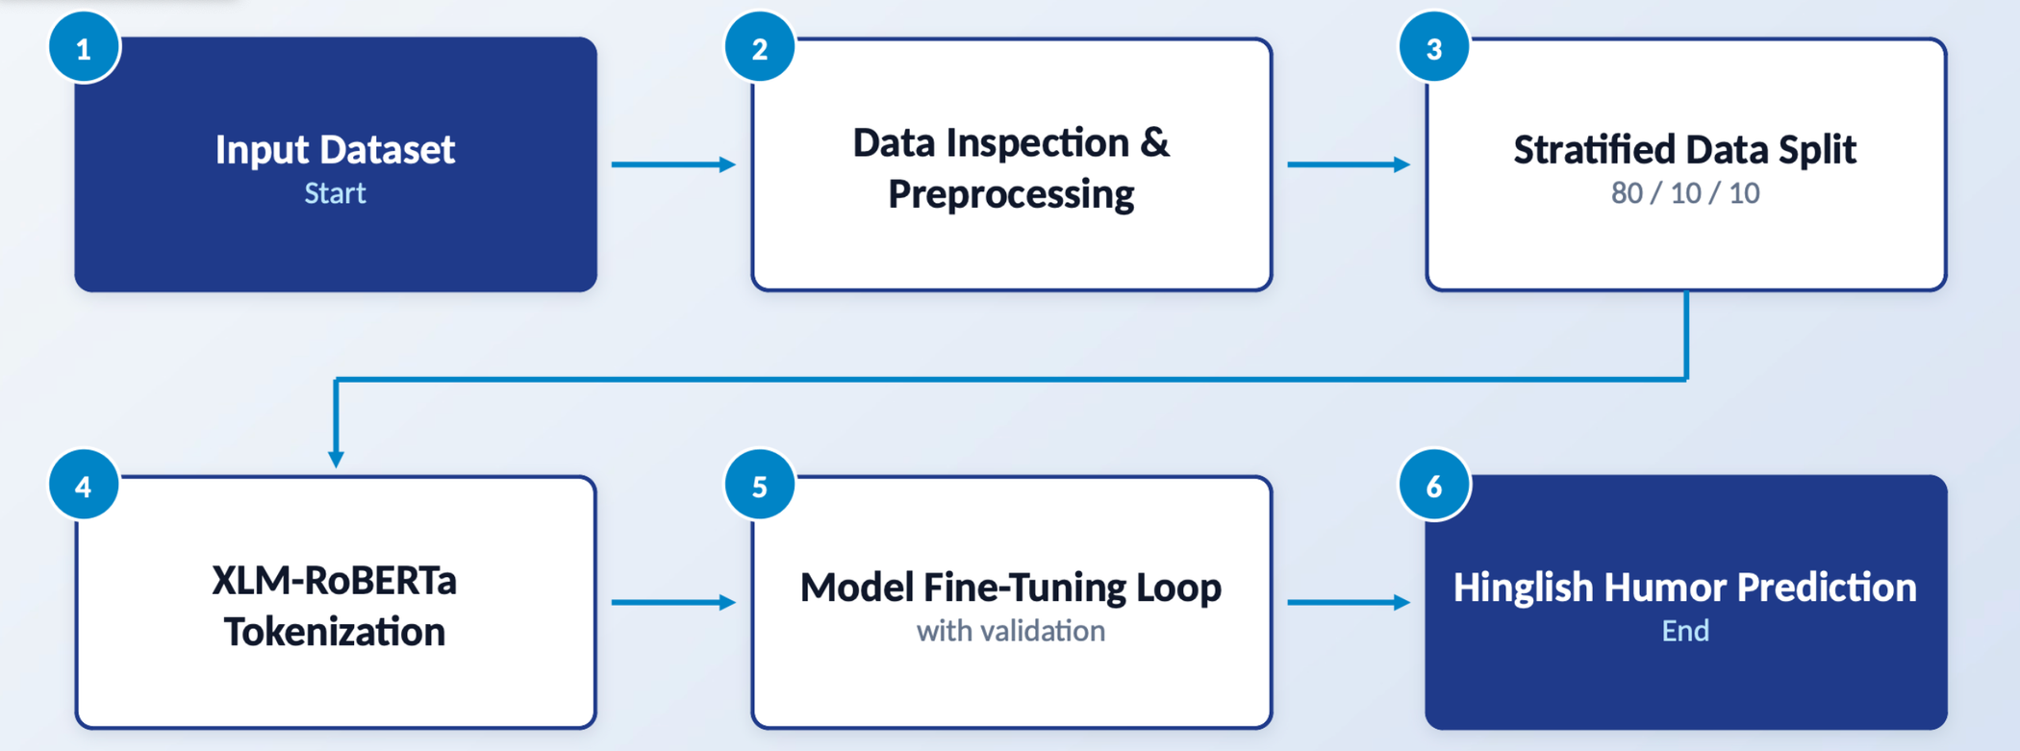
System Diagram / Workflow

Slide 7
Implementation Details
Experimental Environment
Training Configuration
Parameter | Value
Pretrained Model | xlm-roberta-base
Learning Rate | 2×10⁻⁵
Batch Size | 16 (train & eval)
Epochs | 4
Optimizer | AdamW, weight decay 0.01
Precision | Mixed precision (fp16)
PLATFORM
Google Colab (Cloud Notebook)
HARDWARE
NVIDIA Tesla T4 GPU
FRAMEWORKS
Python 3, PyTorch, Hugging Face Transformers
6
Notes:
Explain that you used Google Colab with a Tesla T4 GPU and Hugging Face libraries, and fine-tuned efficiently with mixed precision (fp16).
6

Slide 8
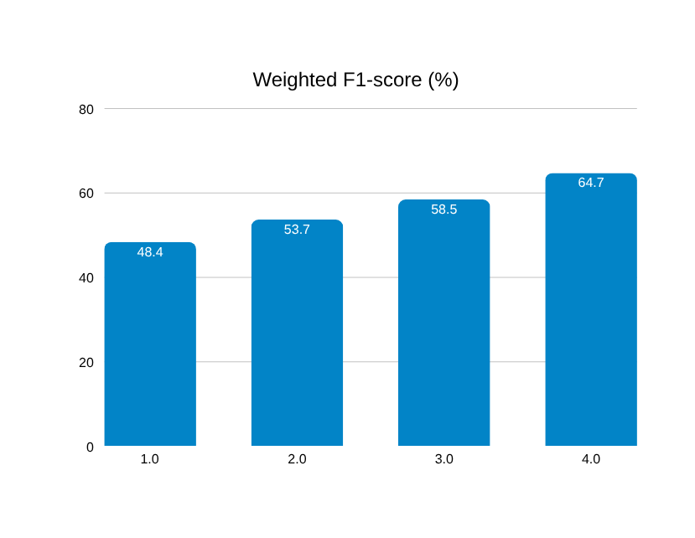
Results, Comparison & Analysis
64%
64.72%
Test Accuracy
Weighted F1-Score
Model | Accuracy | Weighted F1
Majority-Class Guess | 62.75% | 48.39%
Naive Bayes + TF-IDF | 63.26% | 53.68%
Logistic Regression + TF-IDF | 62.11% | 58.45%
XLM-RoBERTa (Proposed) | 64.00% | 64.72%
Key Takeaway: Accuracy gains over the majority baseline are small, but the much higher weighted F1 shows the transformer detects humorous content instead of just predicting the majority class.
7
Notes:
Highlight that classical models such as Logistic Regression lean toward the majority (non-humorous) class, whereas fine-tuned XLM-RoBERTa reaches a balanced F1-score. Optionally insert Table 7 or Fig 5 from your report.
7

Slide 9
Conclusion & Future Scope
Conclusion
Successful Model Adaptation:
  Fine-tuned XLM-RoBERTa-base for binary humor classification on Hindi-English code-mixed (Hinglish) social media text, achieving 64% accuracy and a 64.72% weighted F1-score on unseen test data.
Superiority Over Classical Baselines:
  Significantly outperformed classical TF-IDF models (Naive Bayes 53.68%, Logistic Regression 58.45%, Linear SVM 58.39%) in weighted F1-score, proving that transformer self-attention detects humor far more evenly across both classes rather than collapsing to the majority class.
Identification of Primary Bottlenecks:
  Discovered that overall accuracy is heavily capped by dataset noise (~19.5% conflicting labels) and the absence of prior conversational context, rather than model architectural limits.
Future Scope
Data Reannotation & Curation:
  Manually resolve label conflicts, remove cross-split duplicates, and implement script normalization (standardizing Devanagari vs. Romanized spellings like "tumhari" and "tumhaaree").
Multi-Turn Context Integration:
  Feed preceding dialogue turns alongside the target sentence to capture conversational setup and context-dependent humor.
Model Benchmark Expansion:
  Evaluate and compare performance against Indian language pre-trained models such as MuRIL, IndicBERT,mBERT, and XLM-RoBERTa-large.
Practical System Deployment:
  Wrap the trained transformer pipeline into a REST API / web application for real-time automated social media content moderation and conversational AI integration.
8
Notes:
Summarize what you achieved: transformers are a strong starting point, but cleaner data and conversational context are the keys to future improvement.
8

Slide 10
References
[1] A.Conneau et al., "Unsupervised cross-lingual representation learning at scale," ACL, 2020.
[2] J.Devlin et al., "BERT: Pre-training of deep bidirectional transformers," NAACL, 2019.
[3] A.Vaswani et al., "Attention is all you need," NeurIPS, 2017.
[4] T. Kudo & J. Richardson, "SentencePiece: A simple subword tokenizer," EMNLP, 2018.
[5] Y.Liu et al., "RoBERTa: A robustly optimized BERT pretraining approach," arXiv, 2019.
[6] R.Mihalcea & C. Strapparava, "Making computers laugh: Automatic humor recognition," HLT/EMNLP, 2005.
[10] A.Khandelwal et al., "Humor detection in English-Hindi code-mixed social media," LREC, 2018.
[12] S.Khanuja et al., "GLUECOS: An evaluation benchmark for code-switched NLP," ACL, 2020.
[13] S.Khanuja et al., "MuRIL: Multilingual representations for Indian languages," arXiv, 2021.
[27] M.Sokolova & G. Lapalme, "Performance measures for classification tasks," Inf. Process. Manage., 2009.
Notes:
Conclude smoothly, point to the GitHub link for code, and invite questions from the panel.
9

Slide 11

HUMOR DETECTION IN HINDI-ENGLISH CODE-MIXED TEXT
Thank You
Questions are welcome.
CODE & REPOSITORY
github.com/Sanyam-Jain27/minor-project
</>
Dhruv Nihate · Sanyam Jain
Supervised by Dr. Ringki Das | IIIT Bhopal

